Slide 1
The Mechanics of the Shoulder
Example 2
Milan S. Kovačević
Faculty of Science, Department of Physics
University of Kragujevac
Serbia
e-mails: kovac@kg.ac.rs
milan.kovacevic@pmf.kg.ac.rs
Foča, BiH, 2022.

Slide 2
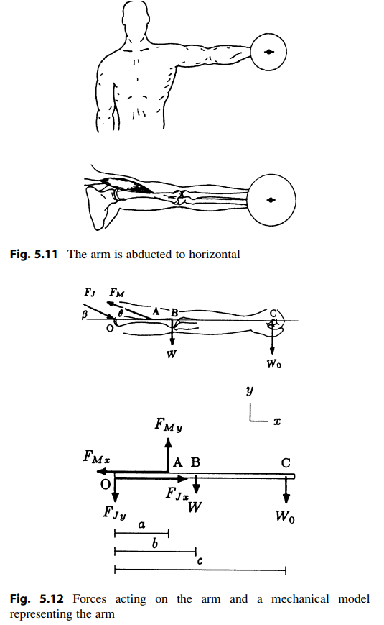
Forces acting on the arm and a mechanical model
Consider a person strengthening the shoulder muscles by means of dumbbell exercises. Figure 5.11 illustrates the position of the left arm when the arm is fully abducted to horizontal.
The free-body diagram of the arm is shown in Fig. 5.12 along with a mechanical model of the arm. Also in Fig. 5.12, the forces acting on the arm are resolved into their rectangular components along the horizontal and vertical directions.
Foča, BiH, 2022.

Slide 3
Mechanical model - description
Point O corresponds to the axis of rotation of the shoulder joint, point A is where the deltoid muscle is attached to the humerus, point B is the center of gravity of the entire arm, and point C is the center of gravity of the dumbbell.
W is the weight of the arm, W_{o} is the weight of the dumbbell, F_{M} is the magnitude of the tension in the deltoid muscle, and F_{j} is the joint reaction force at the shoulder.
The resultant of the deltoid muscle force makes an angle θ with the horizontal. The distances between point O and points A, B, and C are measured as a, b, and c, respectively
Foča, BiH, 2022.

Slide 4
The task
Determine the magnitude F_{M} of the force exerted by the deltoid muscle to hold the arm at the position shown. Also determine the magnitude and direction of the reaction force at the shoulder joint in terms of specified parameters.
Foča, BiH, 2022.

Slide 5
The solution
With respect to the xy coordinate frame, the muscle and joint reaction forces have two components while the weights of the arm and the dumbbell act in the negative y direction. The components of the muscle force are
Components of the joint reaction force are
β is the angle that the joint reaction force makes with the horizontal.
The line of action and direction (in terms of y) of the force exerted by the muscle on the arm are known. However, the magnitude FM of the muscle force, the magnitude F_{j}, and the direction (β) of the joint reaction force are unknowns. We have a total of three unknowns, F_{M}, F_{j}, and β (or FM, F_{Jx}, and F_{Jy}). To be able to solve this two dimensional problem, we have to utilize all three equilibrium equations.
Foča, BiH, 2022.

Slide 6
The Solution
First, consider the rotational equilibrium of the arm about the shoulder joint at point O.
The joint reaction force produces no torque about point O because its line of action passes through it. For practical purposes, we can neglect the possible contribution of the horizontal component of the muscle force to the moment generated about point O by assuming that its line of action also passes through point O. Note that this is not a critical or necessary assumption to solve this problem.
If we knew the length of its moment arm (i.e., the vertical distance between O and A), we could easily incorporate the torque generated by F_{Mx} about point O into the analysis. Under these considerations, there are only three moment producing forces about point O. For the rotational equilibrium of the arm, the net moment about point O must be equal to zero.
Foča, BiH, 2022.

Slide 7
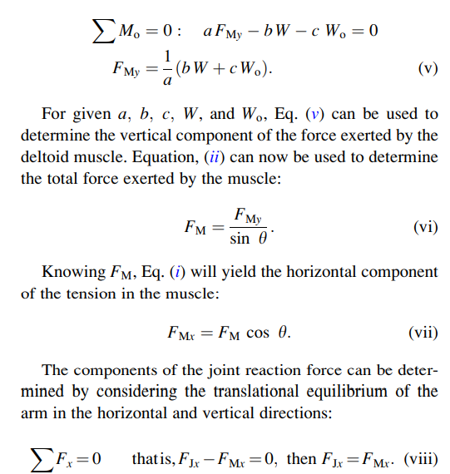
The Solution – moments equations
Taking counterclockwise moments to be positive
Foča, BiH, 2022.

Slide 8
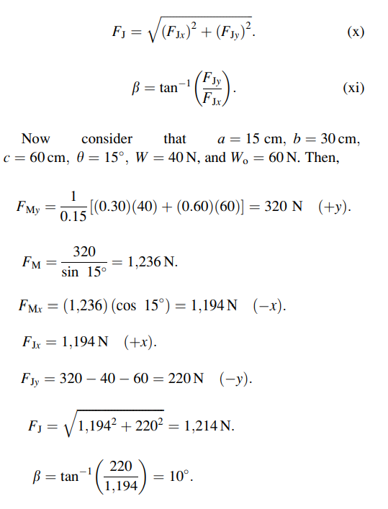
The Solution
Knowing the rectangular components of the joint reaction force enables us to compute the magnitude of the force itself and the angle its line of action makes with the horizontal:
Foča, BiH, 2022.

Slide 9
Remarks
F_{Mx} is the stabilizing component and F_{My} is the rotational component of the deltoid muscle. F_{Mx} is approximately four times larger than F_{My}. A large stabilizing component suggests that the horizontal position of the arm is not stable, and that the muscle needs to exert a high horizontal force to stabilize it.
The human shoulder is very susceptible to injuries. The most common injuries are dislocations of the shoulder joint and the fracture of the humerus. Since the socket of the glenohumeral joint is shallow, the head of the humerus is relatively free to rotate about the articulating surface of the glenoid fossa. This freedom of movement is achieved, however, by reduced joint stability. The humeral head may be displaced in various ways, depending on the strength or weakness of the muscular and ligamentous structure of the shoulder, and depending on the physical activity. Humeral fractures are another common type of injuries. The humerus is particularly vulnerable to injuries because of its unprotected configuration.
Foča, BiH, 2022.

Slide 10
Remarks
Average ranges of motion of the arm about the shoulder joint are 230⁰ during flexion–extension, and 170⁰ in both abduction–adduction and inward–outward rotation.

Slide 11
Thank you for your atention!
Dr Milan Kovačević, Full Professor
Faculty of Science, Department of Physics
University of Kragujevac
kovac@kg.ac.rs
milan.kovacevic@pmf.kg.ac.rs
Foča, BiH, 2022.

